Slide 1
TrustLC: Trust-Minimized Blockchain Escrow for Letter of Credit Trade Finance
Computer Science and Engineering
Aleena M
CHN23CS029
Roshan Joseph
CHN23CS163
Karthik M
CHN23CS110
Vinayak D
CHN23CS195
Guide: Smt. Suvarna Dev
Department of Computer Engineering College of Engineering Chengannur
October 2026

Slide 2
Outline
1 / 24
1 Introduction
2 Problem Statement
3 Literature Review
4 Proposed Solution
5 System Architecture
6 Methodology
7 Functional Requirements
8 Non-Functional Requirements
9 Hardware Requirements
10 Software Requirements
11 Result
12 Conclusion
13 Future Scope
14 References
Introduction Problem Statement Literature Review Proposed Solution
System Architecture Methodology
Functional Requirements
Non-Functional Requirements Hardware Requirements
Software Requirements Result
Conclusion Future Scope
References

Slide 3
Introduction
2 / 24
A Letter of Credit (LC) supports international trade by linking payment to agreed trade conditions, but conventional workflows rely on intermediaries and fragmented information. TrustLC explores a trust-minimized alternative in which an on-chain escrow enforces deal rules and independent attestors report shipment and customs milestones.
Introduction
Problem Statement Literature Review Proposed Solution
System Architecture Methodology
Functional Requirements
Non-Functional Requirements Hardware Requirements
Software Requirements Result
Conclusion Future Scope
References
Core idea
Funds are held by a Solidity escrow, while a 2-of-3 attestor quorum must
agree on the same status and record hash before the lifecycle advances. A future zkTLS layer is designed to prove that the customs portal served the attested record.
Current scope: smart contract, mock customs portal, and React dApp; cryptographic zkTLS attestation remains planned work.

Slide 4
Problem Statement
3 / 24
Traditional Letter of Credit processes rely heavily on intermediaries and manual verification, causing delays, higher costs, and limited transparency, while existing blockchain-based solutions still face challenges in securely verifying real-world shipment and customs information before releasing escrowed funds.
Introduction
Problem Statement
Literature Review Proposed Solution System Architecture
Methodology
Functional Requirements
Non-Functional Requirements Hardware Requirements
Software Requirements Result
Conclusion Future Scope
References

Slide 5
Literature Review
4 / 24
Paper / Year | Approach | Relevant gap
Blockchain and Supply Chain Finance: A Critical Literature Review — Ioan-nou & Demirel (2022) | Reviews research across oper-ations, finance and law, orga-nizing evidence and adoption challenges in supply-chain fi-nance. | Review-level work; few public outcomes from live pilots, while legal frame-works, data quality and industry adoption remain unresolved.
Block by Block: A Blockchain-Based Peer-to-Peer Business Transaction for International Trade — Toorajipour et al. (2022) | Conceptual blockchain-based Letter of Credit (BTLC) pro-cess mapped against conven-tional trade stages. | Proposed mechanism was not implemented or tested; financing, deferred payment and logistics integration re-main outside scope.
Blockchain-Enabled Trade Finance Innovation: A Potential Paradigm Shift on Using Letter of Credit — Chang et al. (2020) | Qualitative cross-case study of five blockchain LC pilots. | Case evidence is descrip-tive and not standardized; technical, legal and interop-erability issues remain.
Introduction Problem Statement Literature Review Proposed Solution
System Architecture Methodology
Functional Requirements
Non-Functional Requirements Hardware Requirements
Software Requirements Result
Conclusion Future Scope
References

Slide 6
Literature Review
5 / 24
Paper / Year | Approach | Relevant gap
Enhanced Security Ap-proach Powered by Blockchain Technology with NFC to Prevent Fraud-ulence in Bank Letter of Credits — Subramaniam et al. (2020) | NFC-enabled physical LC documents with blockchain records to create a tamper-evident handling trail. | Authenticates documents rather than the underlying trade event; no quantitative accuracy, latency or cost evaluation.
Cross-Chain Payment Pro-tocols with Success Guar-antees — van Glabbeek et al. (2023) | Formal models and proofs of safety and liveness for escrow-based cross-chain payments. | No implementation or per-formance measurements; bounded-time guarantees rely on synchrony assump-tions.
DECO: Liberating Web Data Using Decentralized Ora-cles for TLS — Zhang et al. (2020) | Cryptographic protocol for proving statements about HTTPS data using a three-party TLS handshake and two-party computation. | General proof primitive, not an LC/shipment work-flow; WAN latency and application-specific state-ment design are challenges.
Introduction Problem Statement Literature Review Proposed Solution
System Architecture Methodology
Functional Requirements
Non-Functional Requirements Hardware Requirements
Software Requirements Result
Conclusion Future Scope
References

Slide 7
Proposed Solution
6 / 24
TrustLC separates deal enforcement, trade-event data, and user interaction into components that communicate through the escrow contract.
On-chain escrow: stores deal terms and enforces lifecycle transitions, payouts, deadlines, dispute resolution, staking and slashing.
Independent attestors: three designated attestors stake before voting; two matching votes on the same state, status code and record hash advance the deal.
Mock customs portal: provides a stable JSON consignment record and SHA-256 hash for the planned evidence flow.
React dApp: connects a wallet, discovers escrows on the local chain, derives roles and exposes actions for each role.
Planned proof layer: TLSNotary-based zkTLS is selected for future proof of the portal response; current attestations are not yet backed by this proof.
Introduction Problem Statement Literature Review
Proposed Solution
System Architecture Methodology
Functional Requirements
Non-Functional Requirements Hardware Requirements
Software Requirements Result
Conclusion Future Scope
References

Slide 8
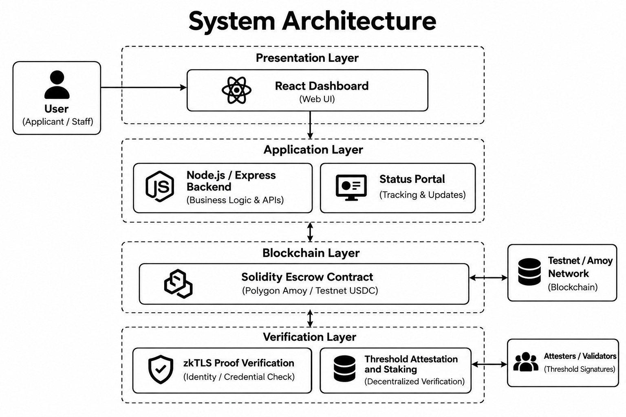
System Architecture
7 / 24
Introduction Problem Statement Literature Review Proposed Solution
System Architecture
Architecture
Use Case Diagram
Data Flow Diagram - Level 0 Data Flow Diagram - Level 1
Methodology
Functional Requirements
Non-Functional Requirements Hardware Requirements
Software Requirements Result
Conclusion Future Scope
References

Slide 9
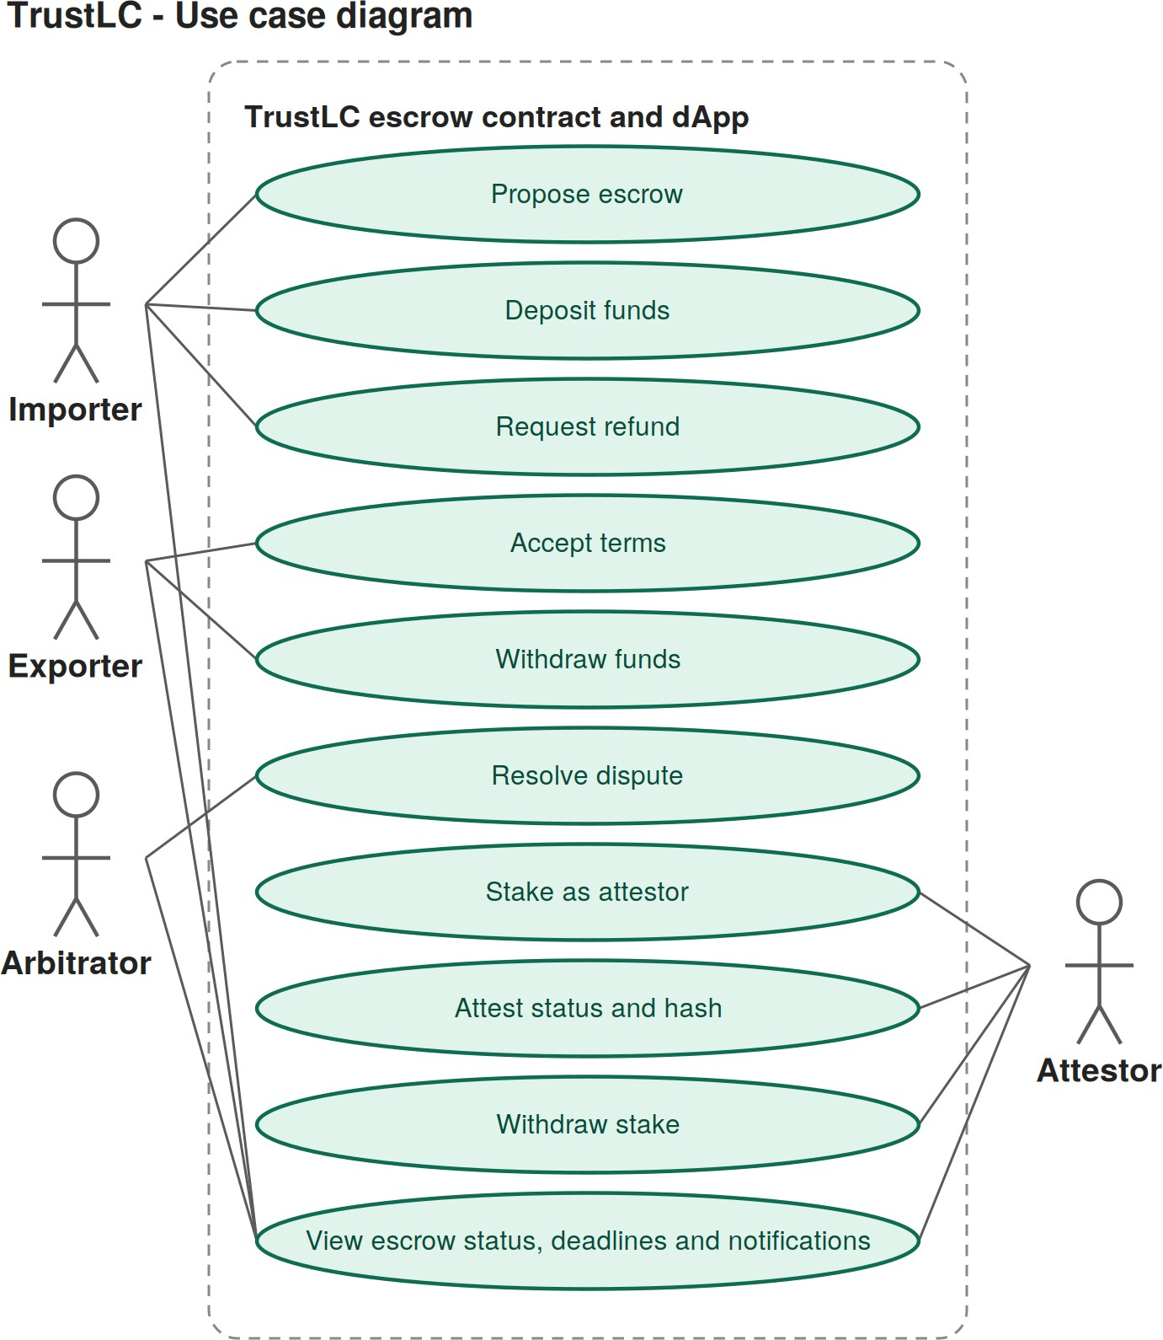
Use Case Diagram
8 / 24
Introduction Problem Statement Literature Review Proposed Solution
System Architecture
Architecture
Use Case Diagram
Data Flow Diagram - Level 0 Data Flow Diagram - Level 1
Methodology
Functional Requirements
Non-Functional Requirements Hardware Requirements
Software Requirements Result
Conclusion Future Scope
References

Slide 10
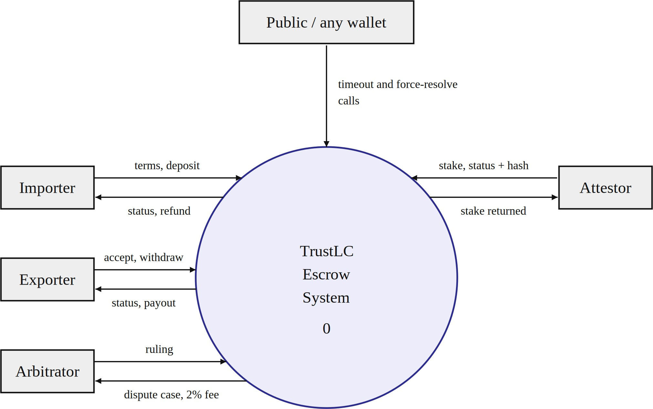
Data Flow Diagram - Level 0
9 / 24
Introduction Problem Statement Literature Review Proposed Solution
System Architecture
Architecture
Use Case Diagram
Data Flow Diagram - Level 0
Data Flow Diagram - Level 1
Methodology
Functional Requirements
Non-Functional Requirements Hardware Requirements
Software Requirements Result
Conclusion Future Scope
References

Slide 11
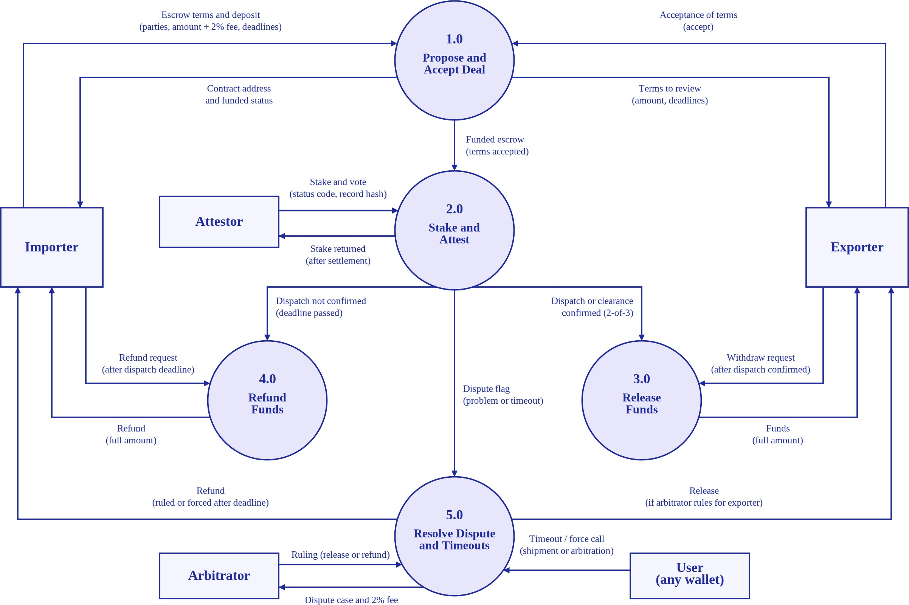
Data Flow Diagram - Level 1
10 / 24
Introduction Problem Statement Literature Review Proposed Solution
System Architecture
Architecture
Use Case Diagram
Data Flow Diagram - Level 0
Data Flow Diagram - Level 1
Methodology
Functional Requirements
Non-Functional Requirements Hardware Requirements
Software Requirements Result
Conclusion Future Scope
References

Slide 12
Methodology
11 / 24
Smart Contract Development: Developed a Solidity-based escrow contract for fund management, payments, refunds, and dispute resolution.
Escrow Workflow: Implemented the complete lifecycle, from proposal and funding to shipment, customs clearance, and settlement.
Attestation and Staking: Implemented attestor staking, 2-of-3 consensus, and stake slashing mechanisms.
Dispute Management: Implemented arbitrator-based resolution and timeout-based refund mechanisms.
Mock Customs Portal: Developed a Node.js and Express portal for consignment tracking and hash-verifiable records.
Testing: Created tests for contract functionality, security, consensus, payouts, and portal integrity.
Frontend Integration: Developed a React dApp using ethers.js and MetaMask for wallet connectivity and escrow interaction.
Introduction Problem Statement Literature Review Proposed Solution
System Architecture
Methodology
Functional Requirements
Non-Functional Requirements Hardware Requirements
Software Requirements Result
Conclusion Future Scope
References

Slide 13
Functional Requirements
12 / 24
Create a deal-specific escrow with validated parties, amount and deadline windows.
Allow exporter acceptance and importer deposit; charge the 2% platform fee at deposit.
Require attestor staking before voting and count matching state/status/hash triples.
Support exporter withdrawal, importer refund, dispute resolution and timeout backstops.
Provide public consignment tracking plus trader and customs-officer workflows in the mock portal.
Connect a wallet in the dApp, derive roles from contract data and display role-appropriate actions.
Introduction Problem Statement Literature Review Proposed Solution
System Architecture Methodology
Functional Requirements
Non-Functional Requirements Hardware Requirements Software Requirements Result
Conclusion Future Scope
References

Slide 14
Non-Functional Requirements
13 / 24
Security: Protects escrow funds through smart contract validation, access control, and secure transaction handling.
Reliability: Ensures consistent escrow state transitions and provides timeout-based recovery mechanisms.
Transparency: Records transactions and escrow state changes on the blockchain for verification.
Integrity: Uses SHA-256 hashes to verify customs records and detect data modifications.
Usability: Provides a React-based interface with wallet connectivity and role-based actions.
Maintainability: Separates the smart contract, customs portal, and frontend into independent components.
Introduction Problem Statement Literature Review Proposed Solution
System Architecture Methodology
Functional Requirements
Non-Functional Requirements
Hardware Requirements Software Requirements Result
Conclusion Future Scope
References

Slide 15
Hardware Requirements
14 / 24
Processor: Intel Core i3 or equivalent and above.
RAM: Minimum 4 GB (8 GB recommended).
Storage: Minimum 10 GB of free disk space.
Network: Internet connection for package installation and blockchain access.
Input/Output Devices: Standard keyboard, mouse, and display.
Wallet Device: Computer supporting a MetaMask-compatible browser.
Introduction Problem Statement Literature Review Proposed Solution
System Architecture Methodology
Functional Requirements
Non-Functional Requirements
Hardware Requirements Software Requirements Result
Conclusion Future Scope
References

Slide 16
Software Requirements
15 / 24
Smart contract: Solidity 0.8.34; Hardhat and ethers toolbox for development/testing.
Customs portal: Node.js, Express 5 and Node’s built-in test runner.
Frontend: React 19, Vite and ethers.js 6.
Wallet: MetaMask or a compatible injected wallet for local-chain interactions.
Planned proof service: Rust / TLSNotary approach selected for Phase 3; not implemented yet.
Network target: local Hardhat chain for the current demo; Polygon Amoy is the stated target, not a claim of current public deployment.
Introduction Problem Statement Literature Review Proposed Solution
System Architecture Methodology
Functional Requirements
Non-Functional Requirements Hardware Requirements
Software Requirements
Result Conclusion Future Scope
References

Slide 17
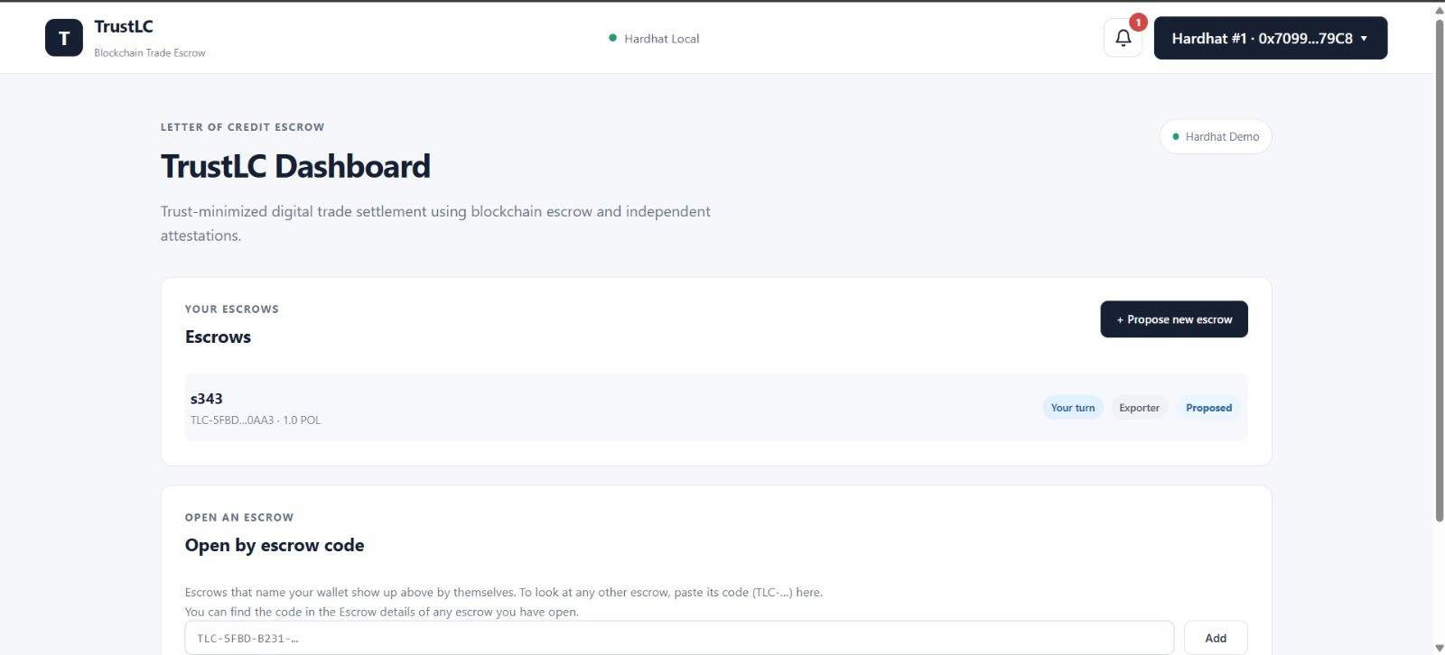
Result
16 / 24
Introduction Problem Statement Literature Review Proposed Solution
System Architecture Methodology
Functional Requirements
Non-Functional Requirements Hardware Requirements
Software Requirements Result
Conclusion Future Scope
References

Slide 18
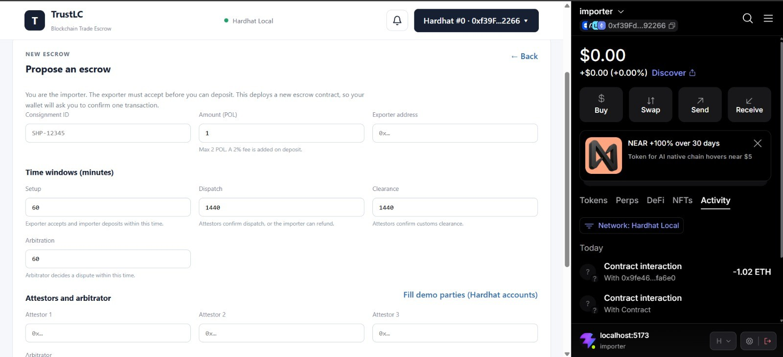
Result
17 / 24
Introduction Problem Statement Literature Review Proposed Solution
System Architecture Methodology
Functional Requirements
Non-Functional Requirements Hardware Requirements
Software Requirements Result
Conclusion Future Scope
References

Slide 19
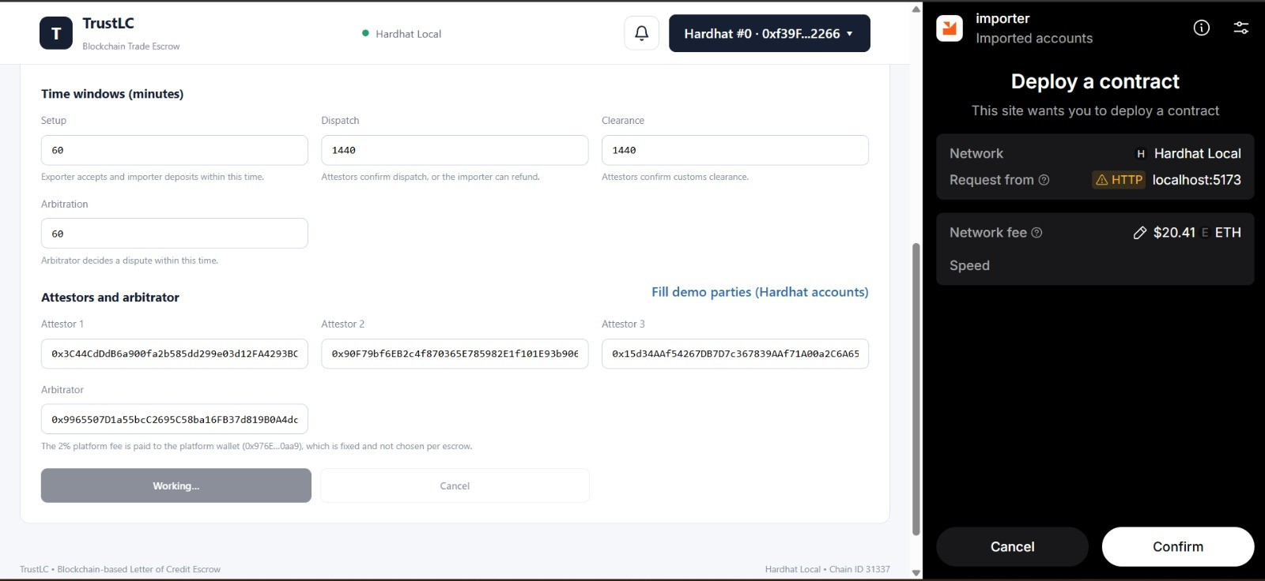
Result
18 / 24
Introduction Problem Statement Literature Review Proposed Solution
System Architecture Methodology
Functional Requirements
Non-Functional Requirements Hardware Requirements
Software Requirements Result
Conclusion Future Scope
References

Slide 20
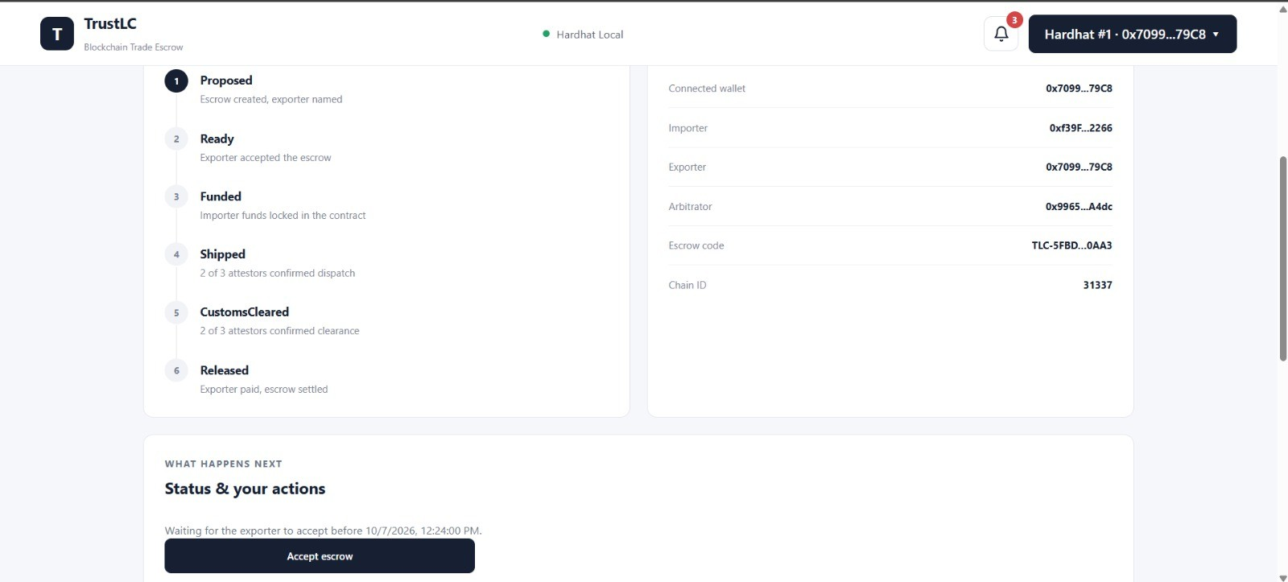
Result
19 / 24
Introduction Problem Statement Literature Review Proposed Solution
System Architecture Methodology
Functional Requirements
Non-Functional Requirements Hardware Requirements
Software Requirements Result
Conclusion Future Scope
References

Slide 21
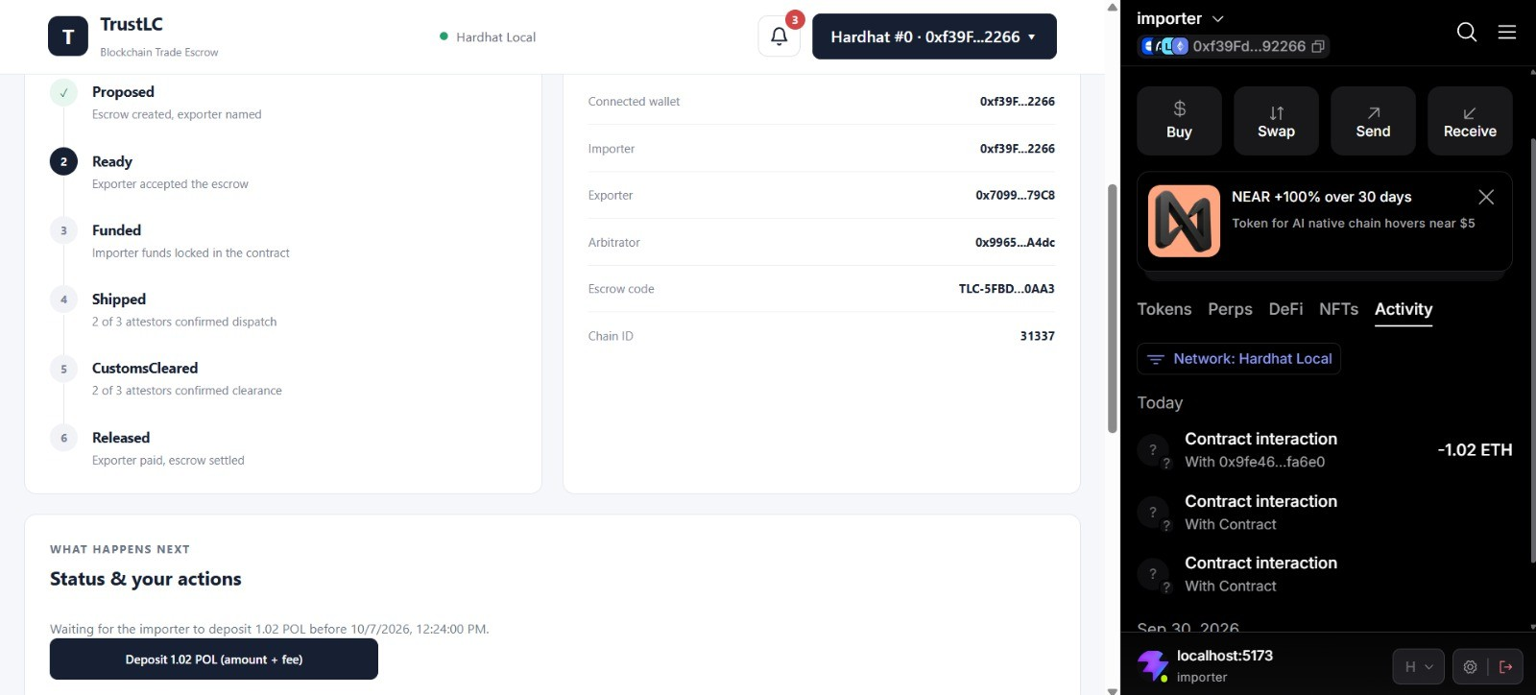
Result
20 / 24
Introduction Problem Statement Literature Review Proposed Solution
System Architecture Methodology
Functional Requirements
Non-Functional Requirements Hardware Requirements
Software Requirements Result
Conclusion Future Scope
References

Slide 22
Conclusion
21 / 24
TrustLC implements a deal-specific Solidity escrow with a defined lifecycle, threshold attestation, staking, dispute handling and timeout recovery.
The mock customs portal provides a stable, hash-verifiable record surface; the React dApp enables participants to interact through wallet-derived roles.
The main contribution is the intended composition of escrow, independent quorum and cryptographic evidence for trade milestones.
The system is not yet fully trust-minimized: current attestations are manually submitted, while the TLSNotary zkTLS layer remains planned.
Introduction Problem Statement Literature Review Proposed Solution
System Architecture Methodology
Functional Requirements
Non-Functional Requirements Hardware Requirements
Software Requirements Result
Conclusion Future Scope References

Slide 23
Future Scope
22 / 24
Implement zkTLS Phase 3: Build the TLSNotary attestor service and verify evidence from a pinned, documented portal endpoint.
Implement reward distribution: Pool fees and slashed stakes and reward attestors in the winning quorum.
Deploy the portal: Resolve the conflicting candidate base URLs before proofs depend on a single endpoint.
Scale escrow discovery: Replace full block scanning with a factory/registry contract and filtered creation events.
Improve frontend assurance: Add tests for role derivation and available actions; introduce event subscriptions with polling as fallback.
Refine economics and governance: Configure economic constants and consider fairer slashing and multi-party arbitration.
Introduction Problem Statement Literature Review Proposed Solution
System Architecture Methodology
Functional Requirements
Non-Functional Requirements Hardware Requirements
Software Requirements Result
Conclusion
Future Scope
References

Slide 24
References
23 / 24
H. Wang, J. Liu, and J. Zhao, “Blockchain smart contracts for decentralized matching of counterparties and automatic settlement of financial derivatives,” Blockchain: Research and Applications, vol. 6, 100300, 2025. doi:10.1016/j.bcra.2025.100300.
J. A. Berrios Moya, J. Ayoade, and M. A. Uddin, “A zero-knowledge proof-enabled blockchain-based academic record verification system,” Sensors, vol. 25, no. 11, 3450, 2025. doi:10.3390/s25113450.
I. Ioannou and G. Demirel, “Blockchain and supply chain finance: a critical literature review at the intersection of operations, finance and law,” Journal of Banking and Financial Technology, vol. 6, pp. 83–107, 2022. doi:10.1007/s42786-022-00040-1.
S. K. Rana, A. K. Rana, S. K. Rana, V. Sharma, U. K. Lilhore, O. I. Khalaf, and A. Galletta, “Decentralized model to protect digital evidence via smart contracts using Layer 2 Polygon blockchain,” IEEE Access, vol. 11, 2023. doi:10.1109/ACCESS.2023.3302771.
R. Toorajipour, P. Oghazi, V. Sohrabpour, P. C. Patel, and R. Mostaghel, “Block by block: a blockchain-based peer-to-peer business transaction for international trade,” Technological Forecasting and Social Change, vol. 180, 121714, 2022.
A. Jin, Y. Ye, B. Lee, X. Li, and Y. Qiao, “PaySwitch: Smart contract-based payment switch for off-chain payment channel networks,” IEEE Access, vol. 13, 2025. doi:10.1109/ACCESS.2025.3527746.
Introduction Problem Statement Literature Review Proposed Solution
System Architecture Methodology
Functional Requirements
Non-Functional Requirements Hardware Requirements
Software Requirements Result
Conclusion Future Scope
References

Slide 25
References
24 / 24
S. Meralli, “Privacy-preserving analytics for the securitization market: a zero-knowledge distributed ledger technology application,” Financial Innovation, vol. 6, no. 7, 2020. doi:10.1186/s40854-020-0172-y.
R. Subramaniam, S. R. Azzuhri, and Y. W. Teh, “Enhanced security approach powered by blockchain technology with NFC to prevent fraudulence in bank Letter of Credits,” ACM, 2020. ISBN 978-1-4503-7770-6.
D. Li, D. Han, N. Crespi, R. Minerva, and Z. Sun, “Fabric-SCF: A blockchain-based secure storage and access control scheme for supply chain finance,” arXiv:2111.13538, 2021.
Introduction Problem Statement Literature Review Proposed Solution
System Architecture Methodology
Functional Requirements
Non-Functional Requirements Hardware Requirements
Software Requirements Result
Conclusion Future Scope
S. E. Chang, H. L. Luo, and Y. Chen, “Blockchain-enabled trade finance innovation: a potential paradigm shift on using Letter of Credit,” Sustainability, vol. 12, no. 1, 188, 2020.
R. van Glabbeek, V. Gramoli, and P. Tholoniat, “Cross-chain payment protocols with success guarantees,” Distributed Computing, vol. 36, pp. 137–157, 2023. doi:10.1007/s00446-023-00446-0.
F. Zhang, D. Maram, H. Malvai, S. Goldfeder, and A. Juels, “DECO: Liberating web data using decentralized oracles for TLS,” in ACM CCS ’20, 2020. doi:10.1145/3372297.3417239.
References

